Slide 1
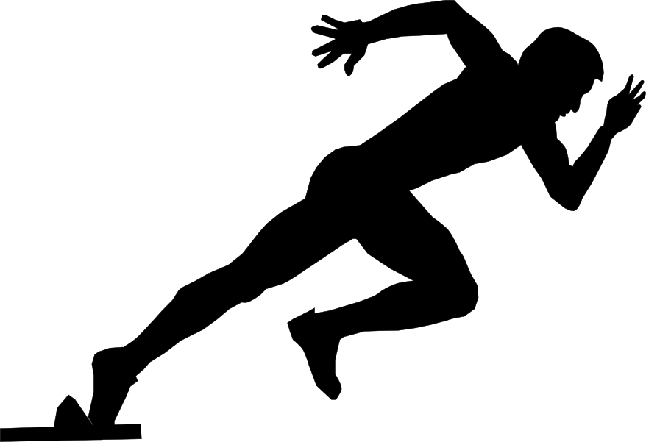


EXERCISE
TRACKER
ITCS424
WIRELESS AND MOBILE COMPUTING

Slide 2

MOTIVATION
People are more concerned about their own health.
Some gadgets, such as Fitbit, and Garmin, are widely used.
This motivated us to think about the application that could track the exercise data such as workout time, Heart rate, and Calories burned

Slide 3
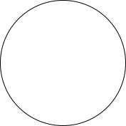
OUR OBJECTIVE
Tracking of the time spent in each exercise
Check for the amount of steps that they took each day
Calculated the burned calories daily.
Providing a graphical analysis

Slide 4

SCOPE
A real-time functional exercise tracker
A recording on the data taken
A Firestore database that is able to keep track of the steps.

Slide 5
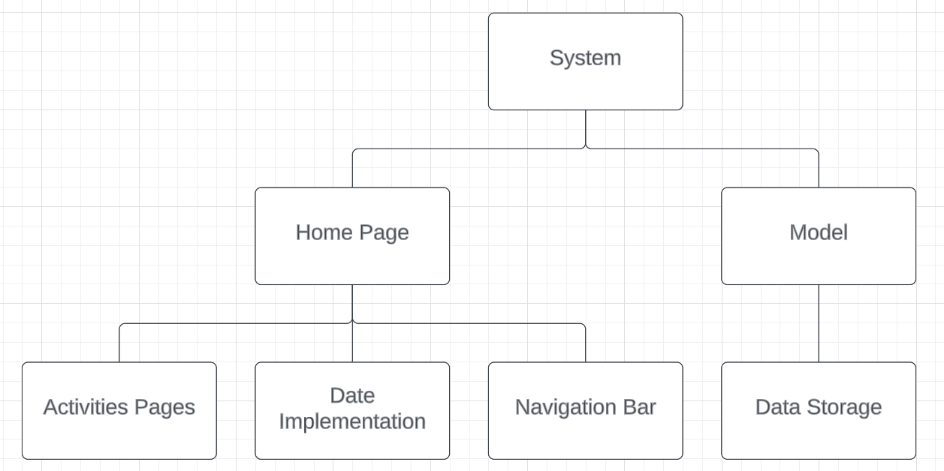
DESIGN STRUCTURE
Mission
The user interface will display the recent activities for the user by displaying calories, distance, and exercising hours per tasks
The model are created a hard coding API and applying to our main application.

Slide 6
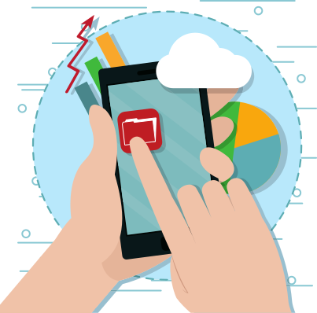
IMPLEMENTATION

Slide 7




IMPLEMENTATION
DART
ANDROID STUDIO
FLUTTER
VISUAL STUDIO CODE

Slide 8
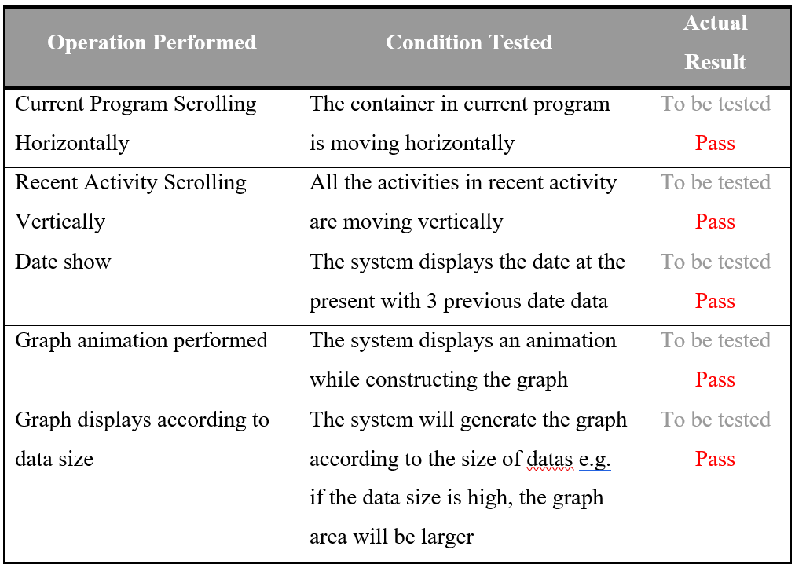
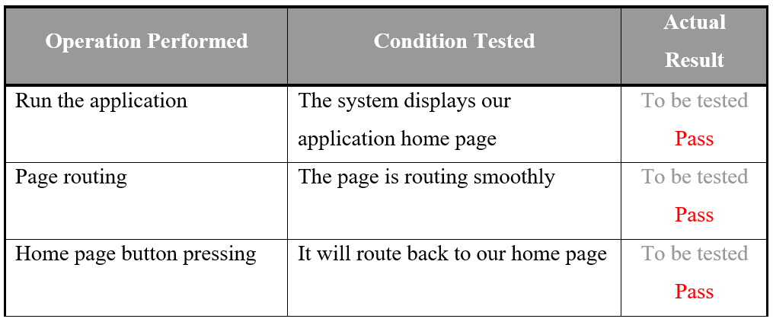
TESTING

Slide 9
CONCLUSION
By working on this project, we gained a lot of knowledge in developing mobile applications by using flutter. Furthermore, this knowledge we earn could be develop further in the future by enhancing the application to be more functional.

Slide 10
FUTURE WORK
1
2
3
Developing further on this application to be more effective
Apply sensor access into the application
Improving the data store efficiency by using firebase instead

Slide 11
GITHUB
HTTPS://GITHUB.COM/PAPONJ

Slide 12


